Slide 1
Team K ‘Karate Kicking Kangaroos’
James Wilson,
James Gormley,
Kritika Nautiyal,
Jason Kavanagh

Slide 2
Project Summary
Why a website?
Allow for staff members, customers (signed up) & public access
We will make it secure
To compete with other companies
It will contain a database of DVD’s available in the store as well as databases of reservations and users
This will allow real time information to be viewed

Slide 3
Assumptions & Dependencies
This system will be relying on the amount of customers that may have signed up, so it gives the admin’s more functionality, in that they intend to track the amount of customers that have the same rental movie and seek to obtain the rentals that a customer may want.
The customer as an end user, will also be dependent on their emails, as they will receive one prior to their favorite DVD release date.

Slide 4
High Level System Architecture
This system will be implemented as a webpage
Use javascript, CSS, HTML5, PHP.
Local SQL Database

Slide 5
Development Methods
Agile Methodology
Working software over comprehensive documentation.
Customer collaboration over contract negotiation.
Adaptive over prescriptive. Responding to change rather than follow a plan.
HTML5, CSS, PHP, Javascipt
Notepad++, sublime text, Eclipse

Slide 6
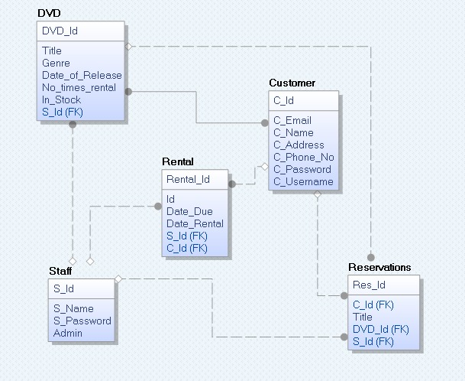
ERD Database Design

Slide 7
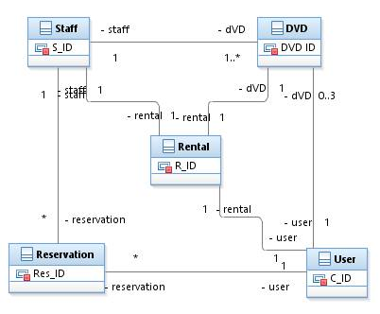
Detailed System Design
Class Diagram

Slide 8
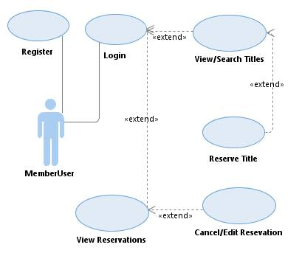
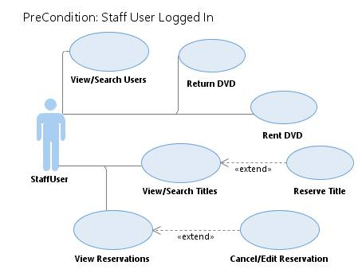
USE Case Diagrams

Slide 9
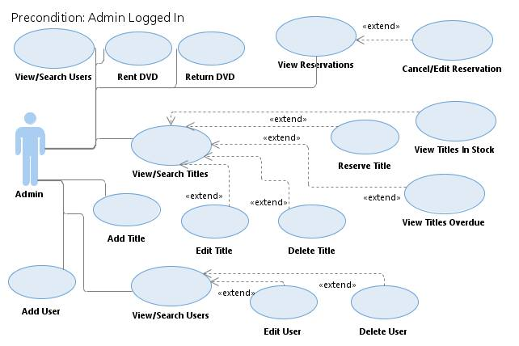

Slide 10
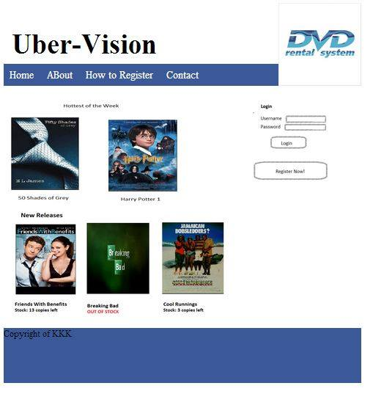
GUI Prototypes: HomePage

Slide 11
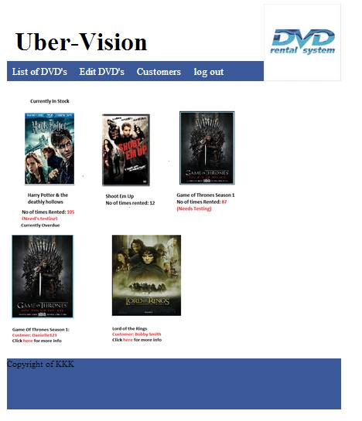
Staff Member Log in

Slide 12
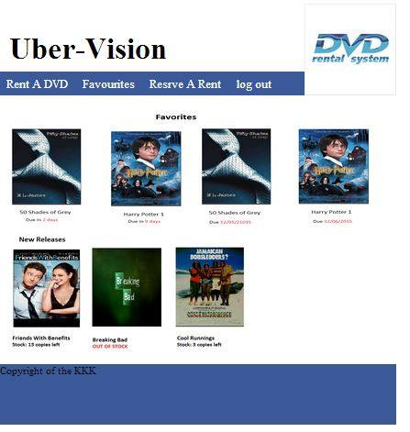
Customer Log in

